Slide 1

Customer Segmentation
B SANTOSH KUMAR 18BCE10081
P NILE KRUPA SHEEL 18BCE10183
P C V V MOUNISH 18BCE10187
Thodupunoori MAHESH 18BCE10280
WANTA Kumar Oinam 18BCE10322
DHRITIMAN keot 18BCG10038

Slide 2
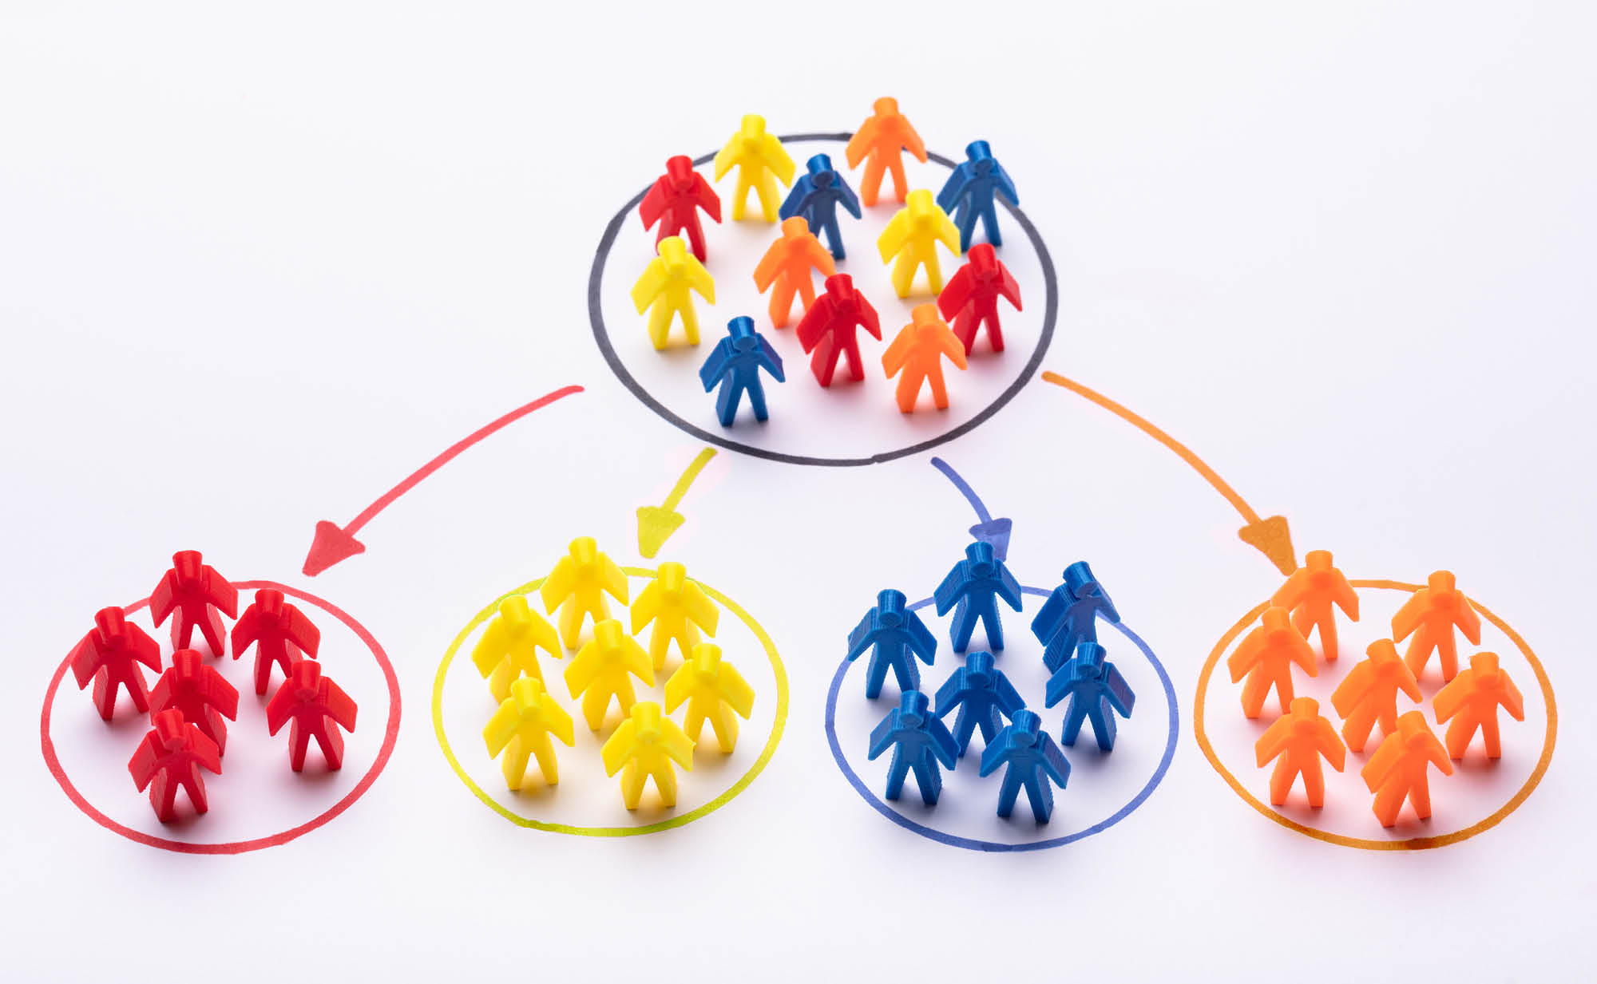
Customer Segmentation :
Customer Segmentation is the process of division of customer base into several groups of individuals that share a similarity in different ways that are relevant to marketing such as gender, age, interests etc.
Companies aim to gain a deeper approach of the customer they are targeting.
Furthermore, through the data collected, companies can gain a deeper understanding of customer preferences as well as the requirements for discovering valuable segments that would reap them maximum profit.

Slide 3
Using clustering techniques, companies can identify the several segments of customers allowing them to target the potential user base.
Clustering is the most common customer segmentation data mining techniques. In Cluster analysis, we gather a bunch of objects and separate them into groups of similar objects.
Here we will make use of R implementation and the K-means clustering which is the essential algorithm for clustering unlabeled dataset.
Objective:
To categorize and segment customers into meaningful groups with respect to variables such as gender, age, income, spending score, etc. using R and K-Means clustering
Dataset:
https://www.kaggle.com/aramdabaghyan/interesting-visualizations-to-spending-score

Slide 4
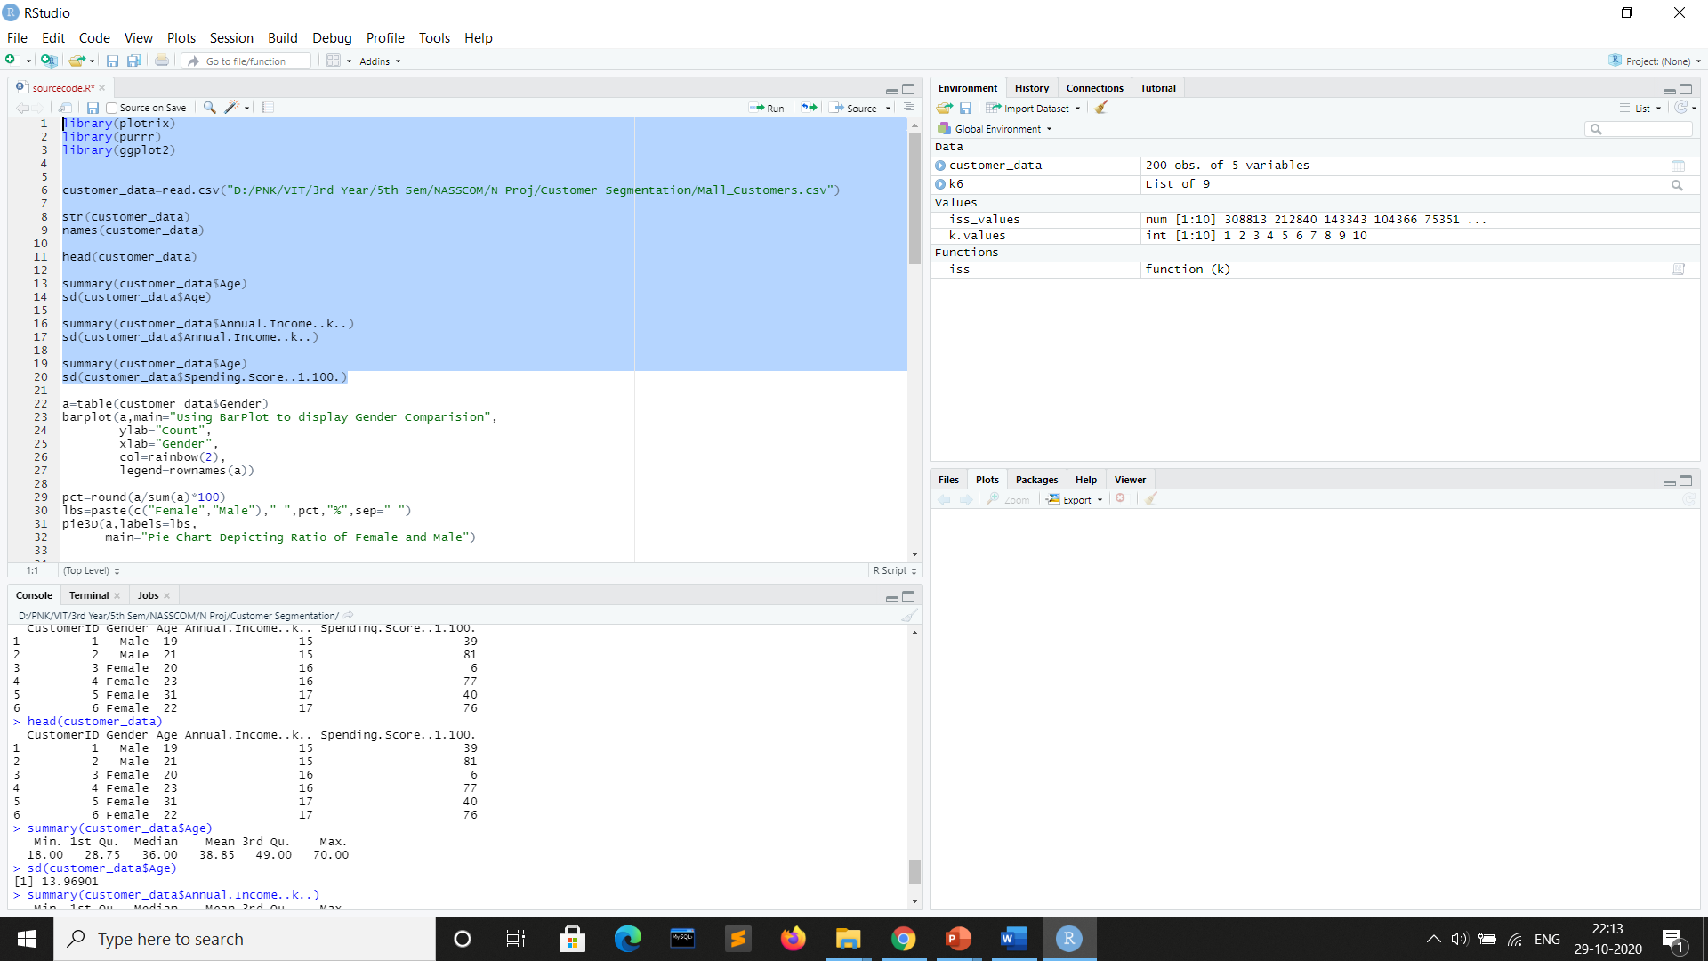
Data Exploration

Slide 5
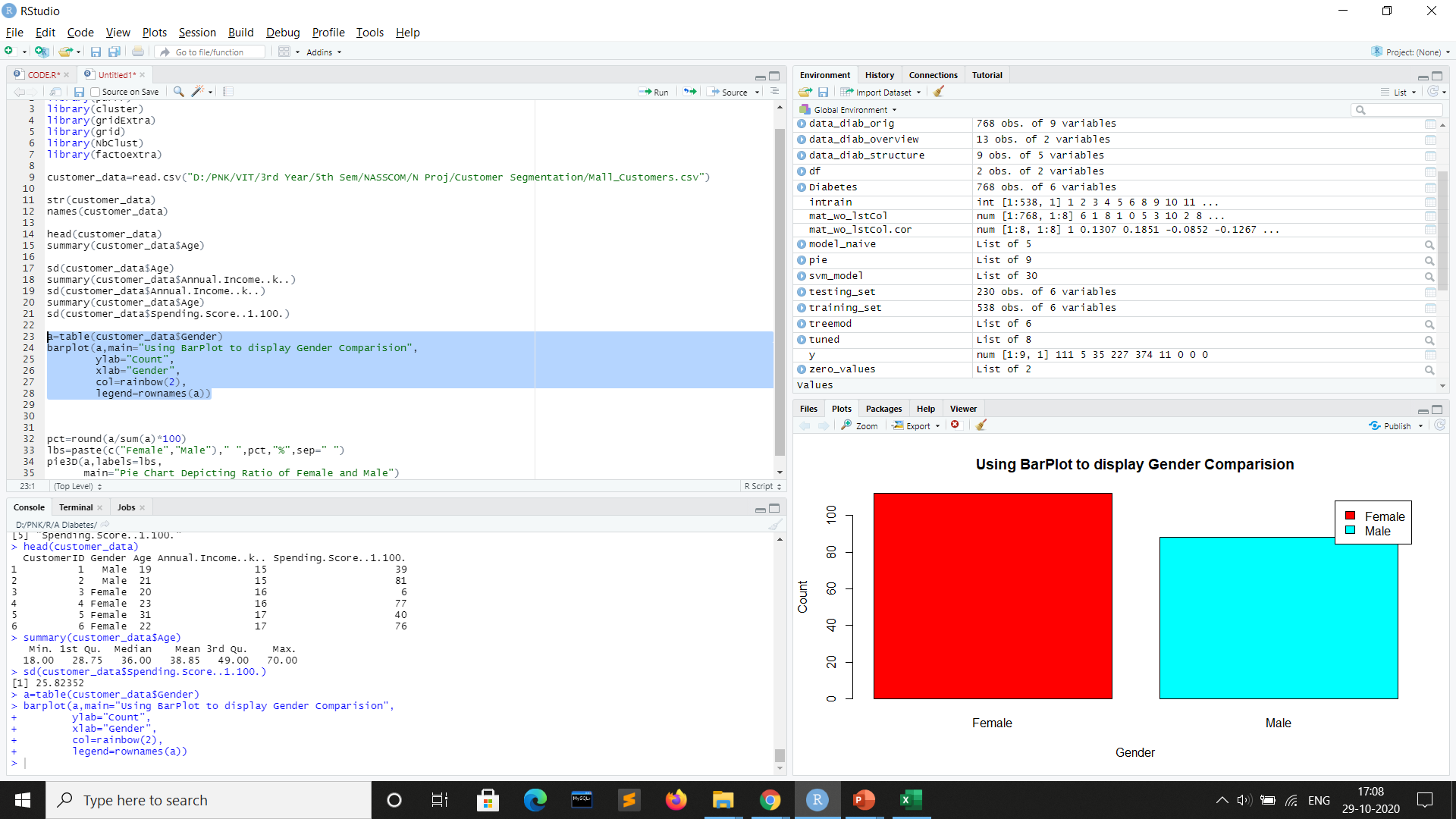
Gender Visualization – Bar Plot

Slide 6
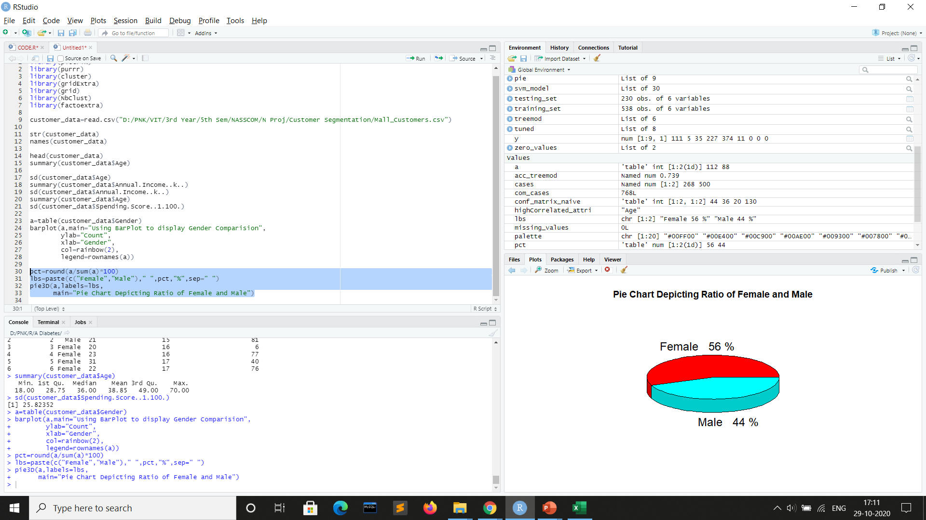
Gender Visualization – Pie Chart

Slide 7
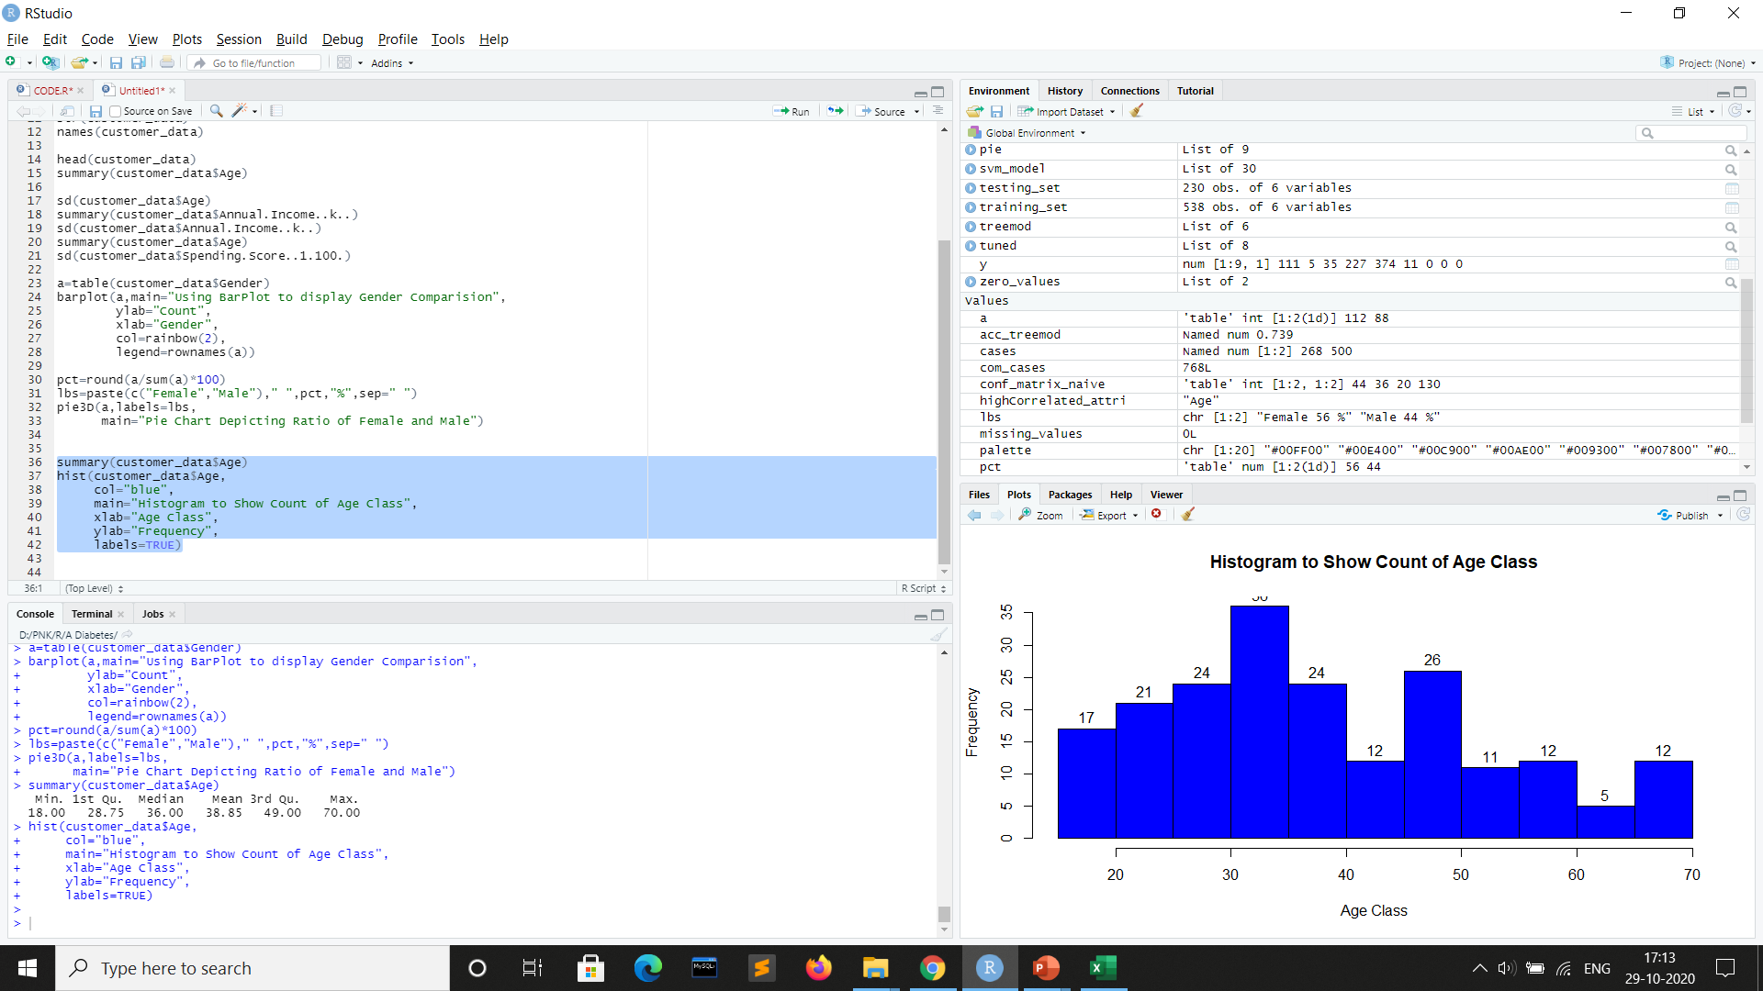
Age Visualization – Histogram

Slide 8
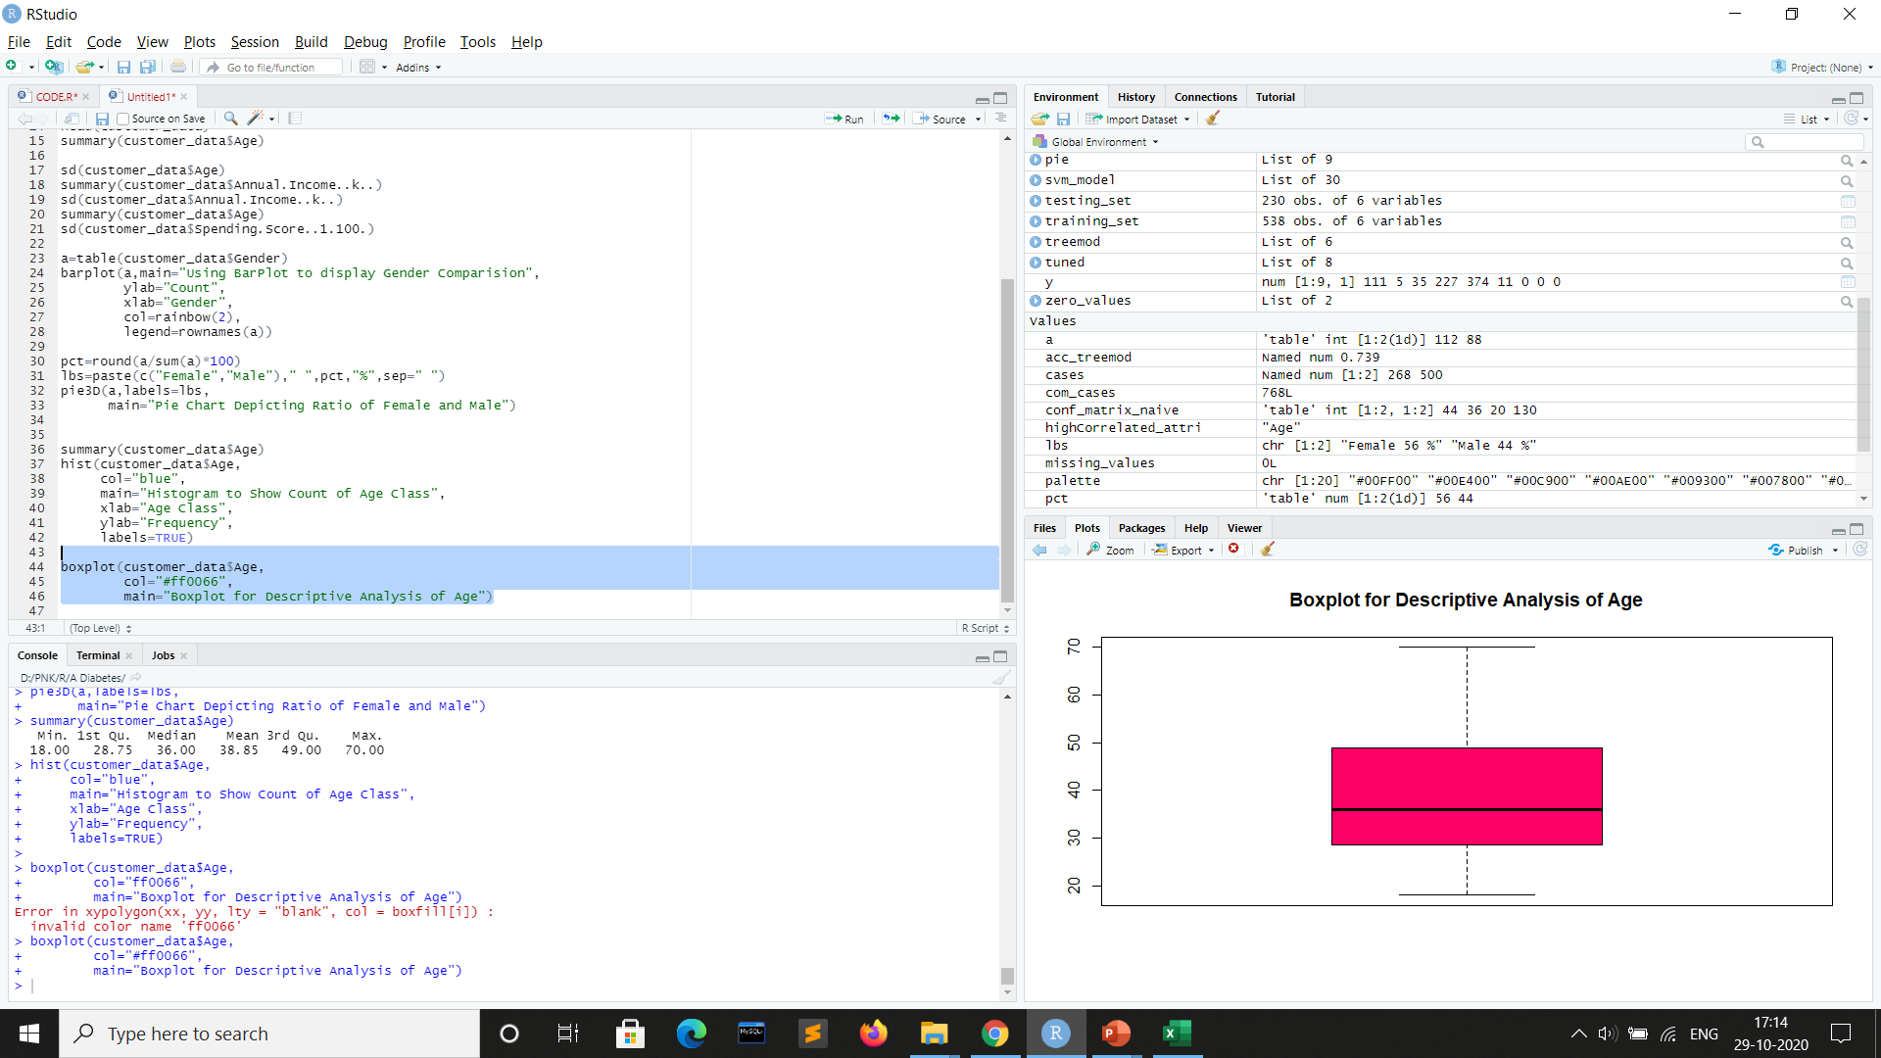
Age Visualization – Box Plot

Slide 9
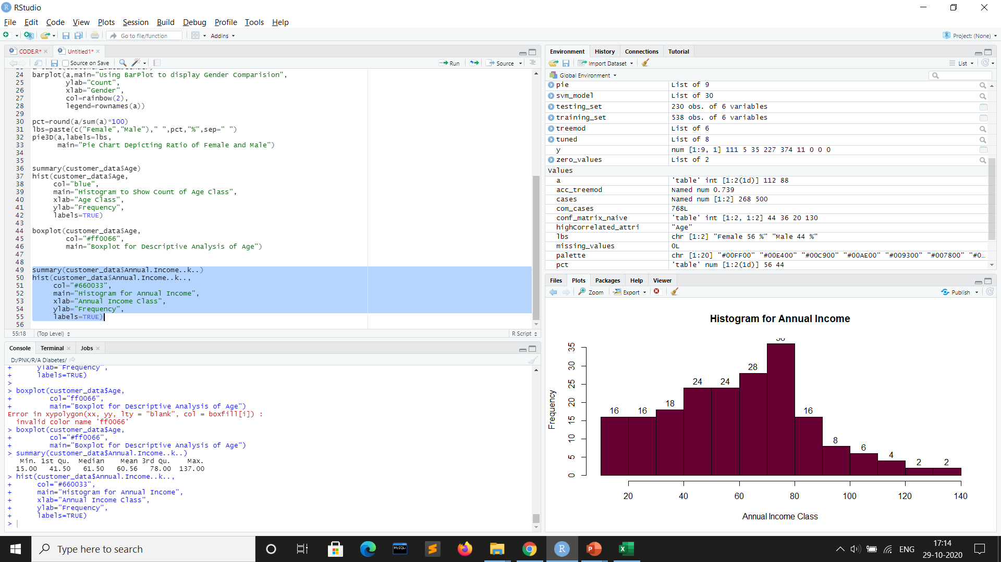
Annual Income Visualization - Histogram

Slide 10
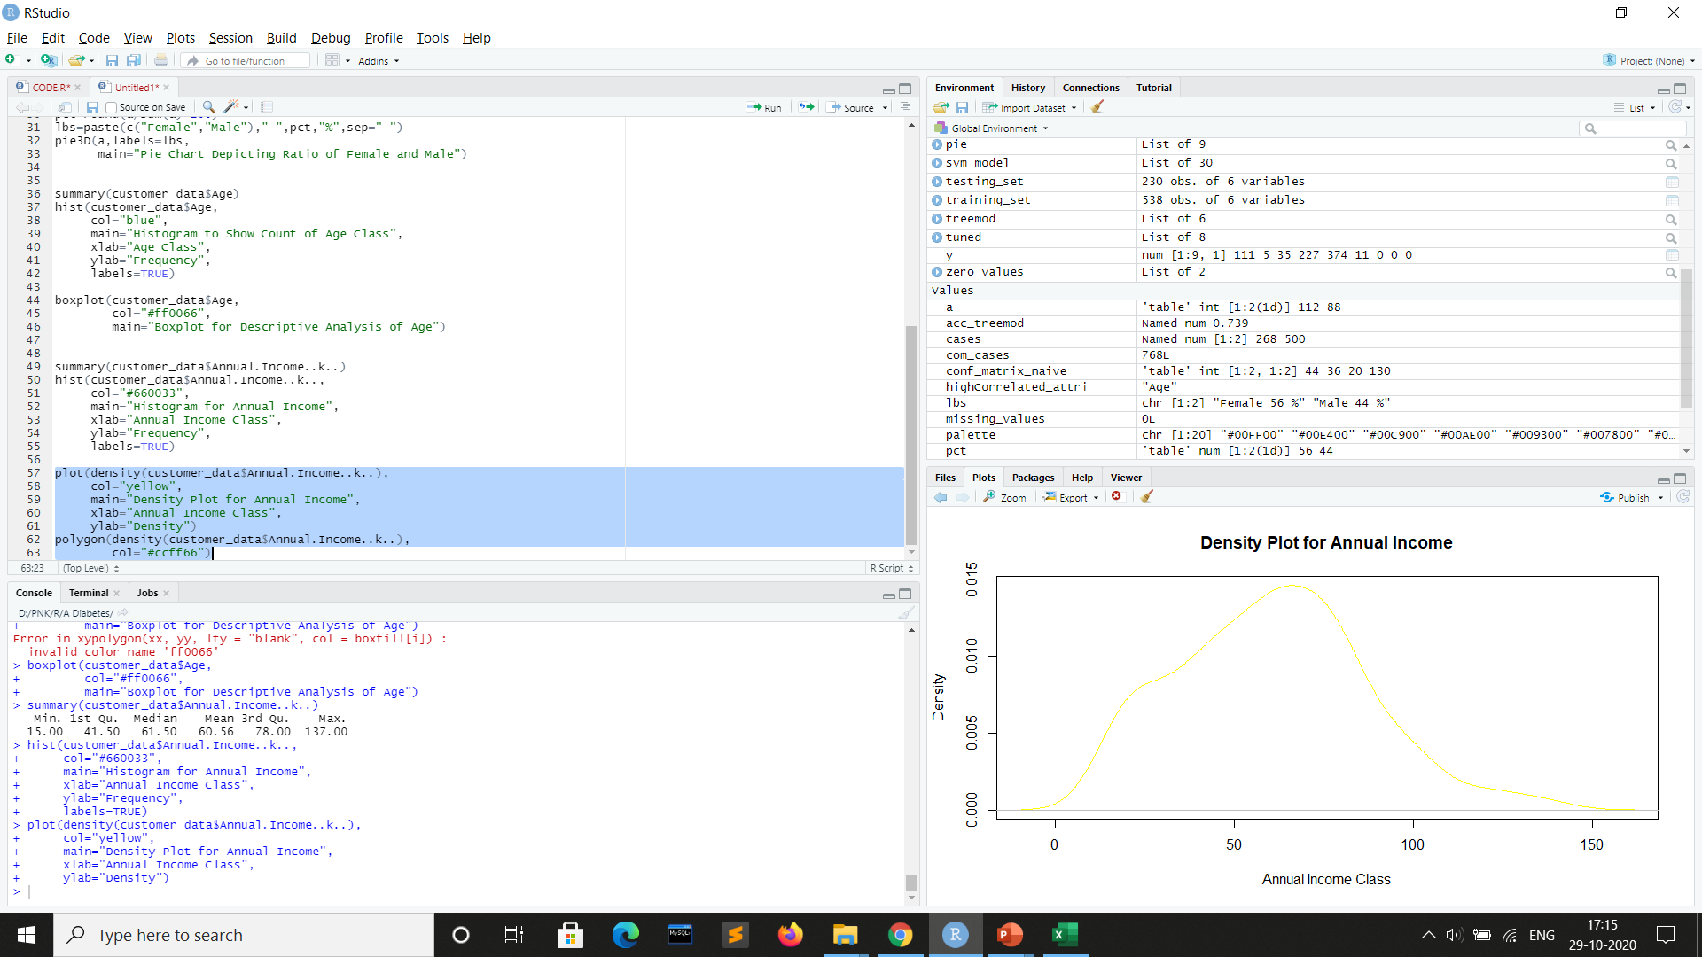
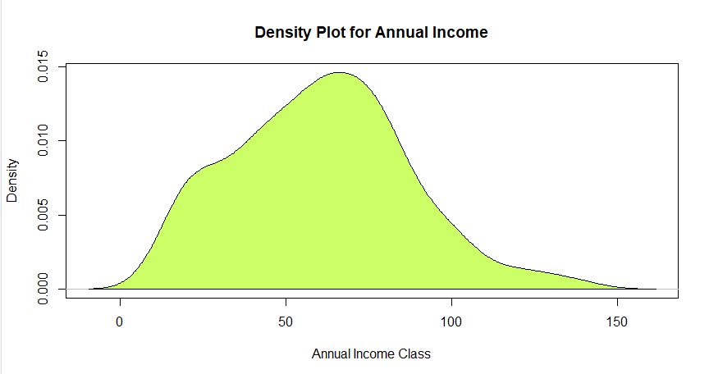
Annual Income Visualization – Density Plot

Slide 11
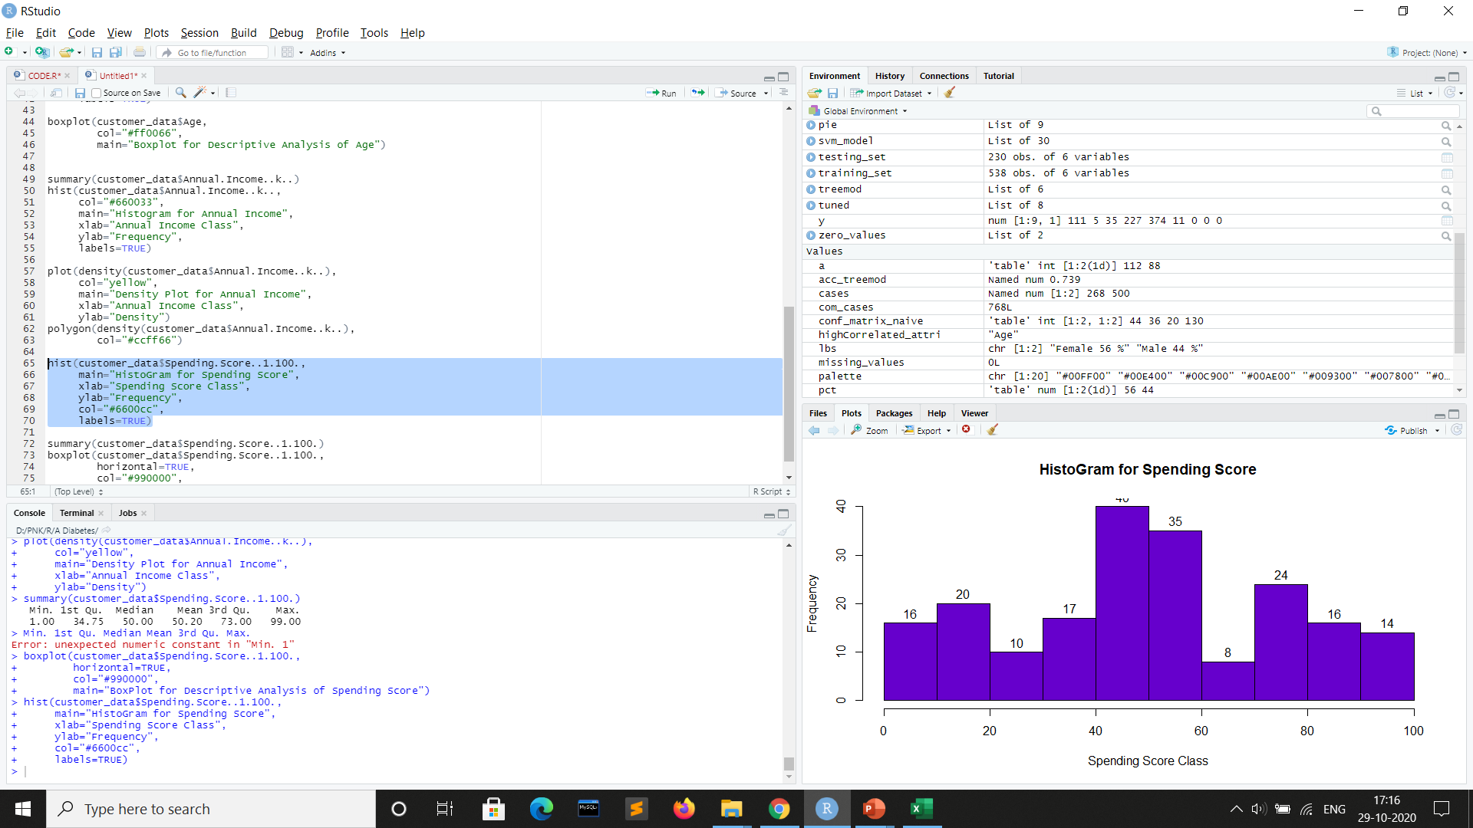
Spending Score Visualization – Histogram

Slide 12
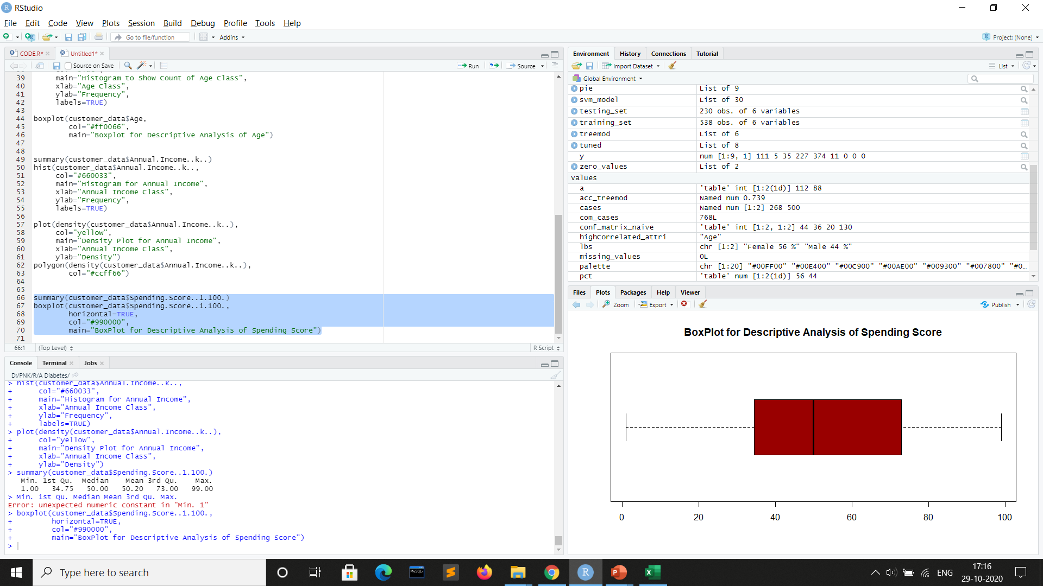
Spending Score Visualization – Box Plot

Slide 13
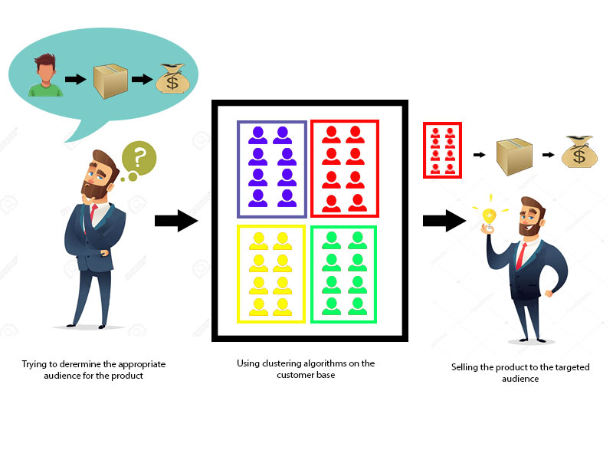
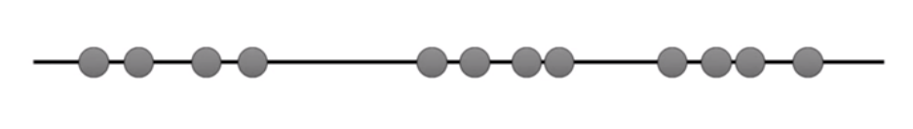
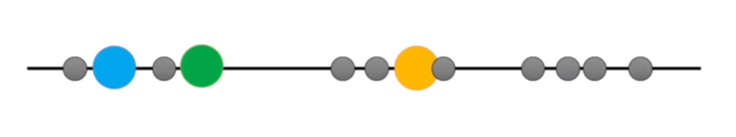
K-Means Clustering
Imagine that we have some data something like this where we knew that we are supposed to put it into 3 clusters. So, by normal vision, we divide the data into 3 clusters in this way.
But if the same clustering is done through a computer, let us see how it turns out to be,
Step 1 – We need to identify the number of clusters we want to divide to (k). Here k = 3.
Step 2 – Randomly select 3 distinct data points, and these are the initial clusters.

Slide 14
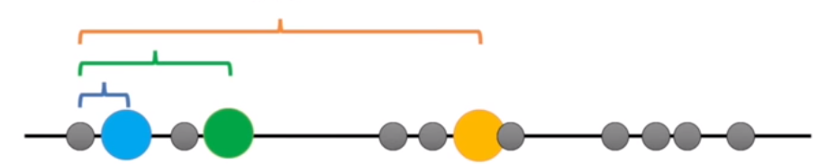
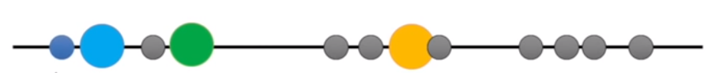
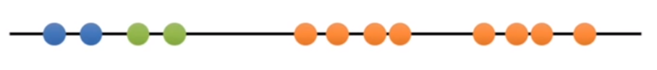
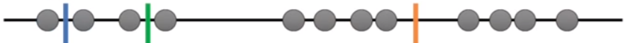
Step 3 – Measure the distance between the 1st point with the 3 initial clusters.
Step 4 – Assign the 1st point to the nearest cluster.
So here, the nearest cluster is blue, so the 1st point turns out to blue.
Step 5 – We follow the same method for all the remaining data points and assign each data point to it’s nearest initial cluster accordingly.
Step 6 – Now we calculate the mean of each cluster.
Step 7 – We measure each data point with the mean values and assign the data point to it’s nearest mean value initial cluster

Slide 15
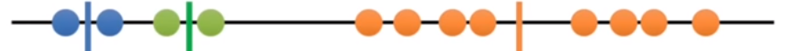
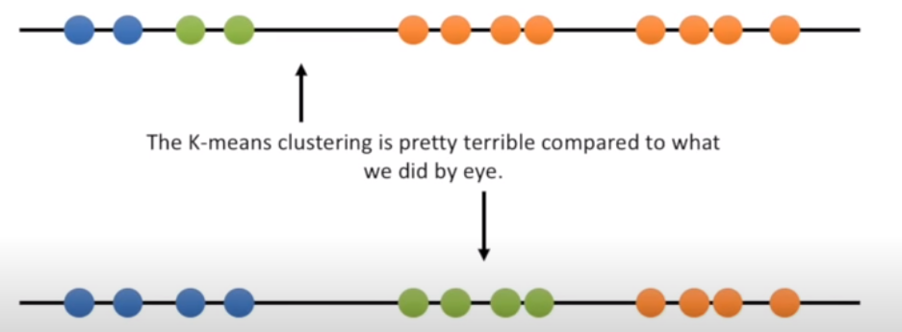
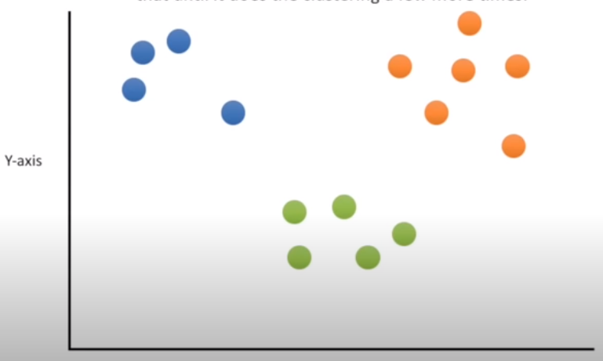
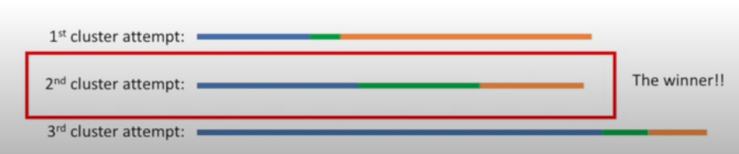
Step 8 – Even after this iteration, the cluster did not change with step 5.
So this concludes the K – Clustering method.
On comparing the clustering we did by eye and that done by K-means clustering method, we notice the difference.
In this way, K-means clustering is done with various initial cluster points and various mean values and takes the best clustering.

Slide 16
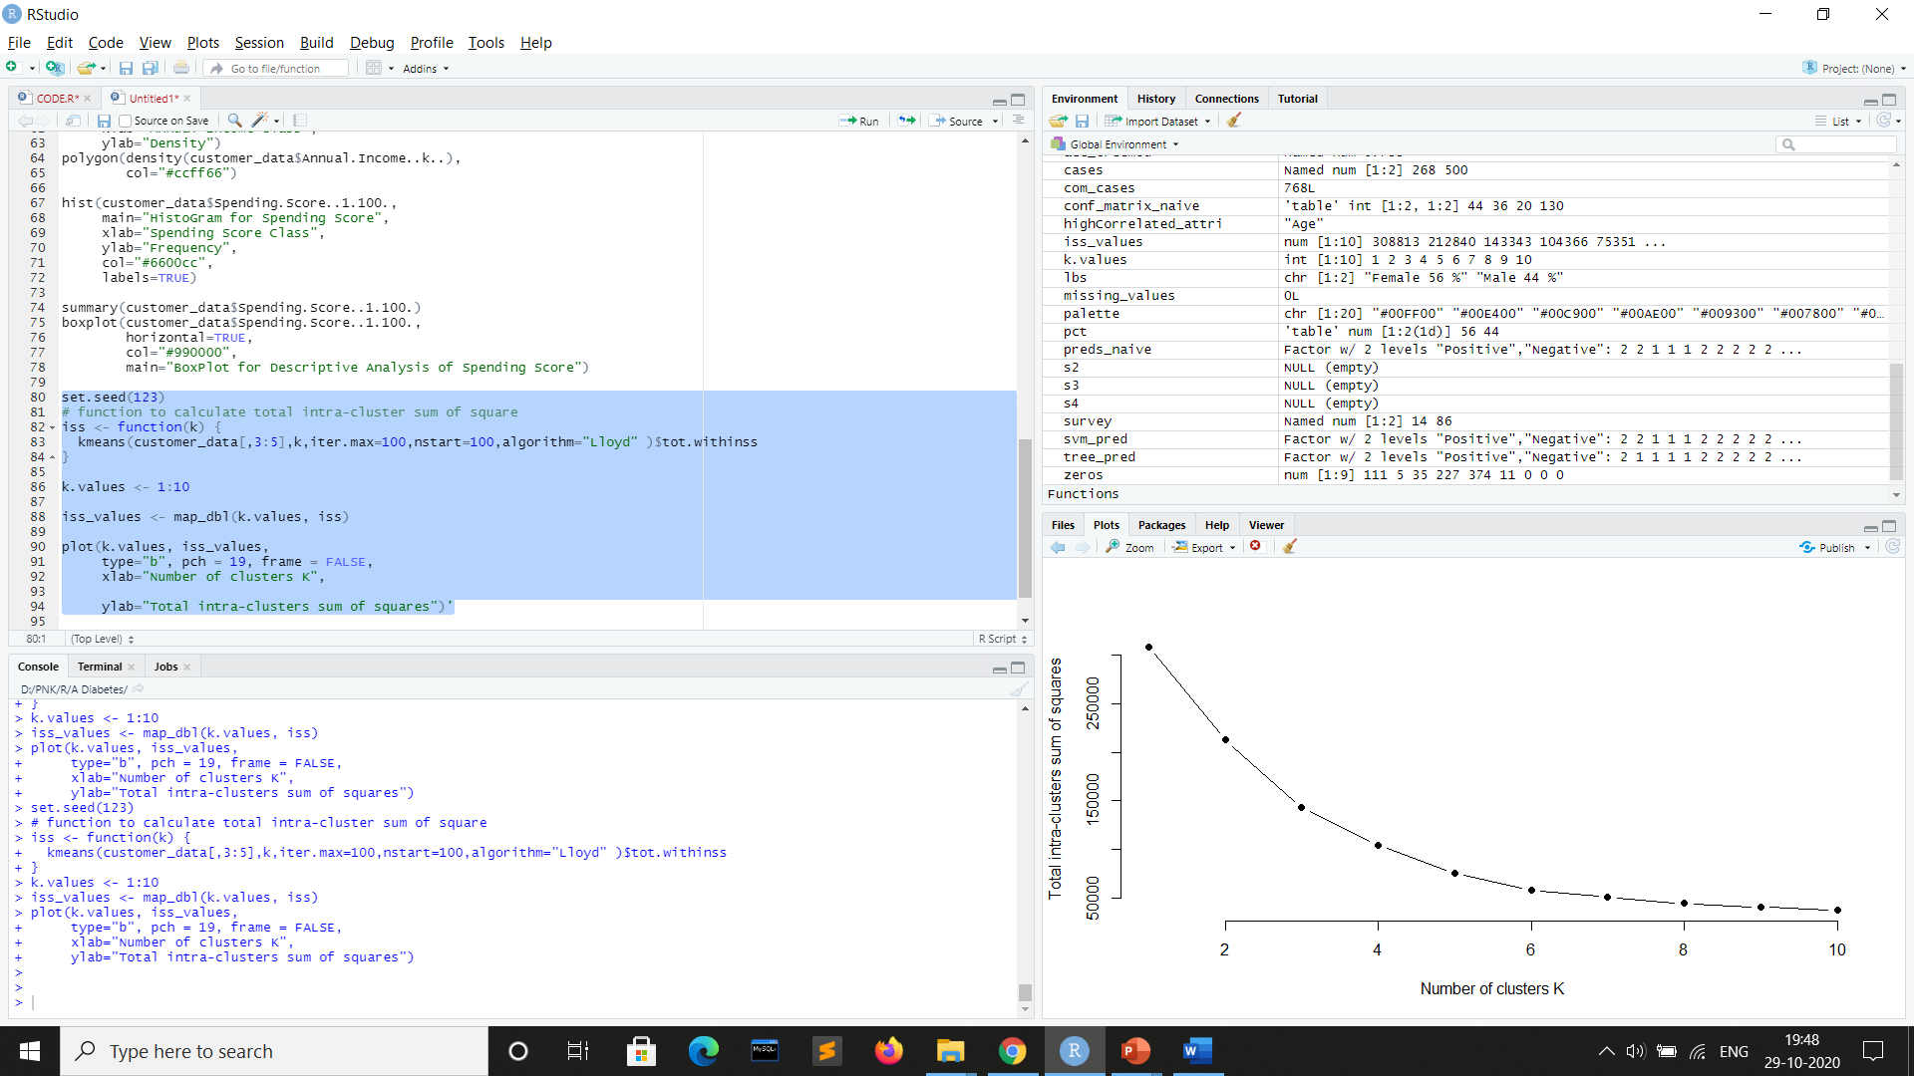
K- Means Algorithm: Elbow Method

Slide 17
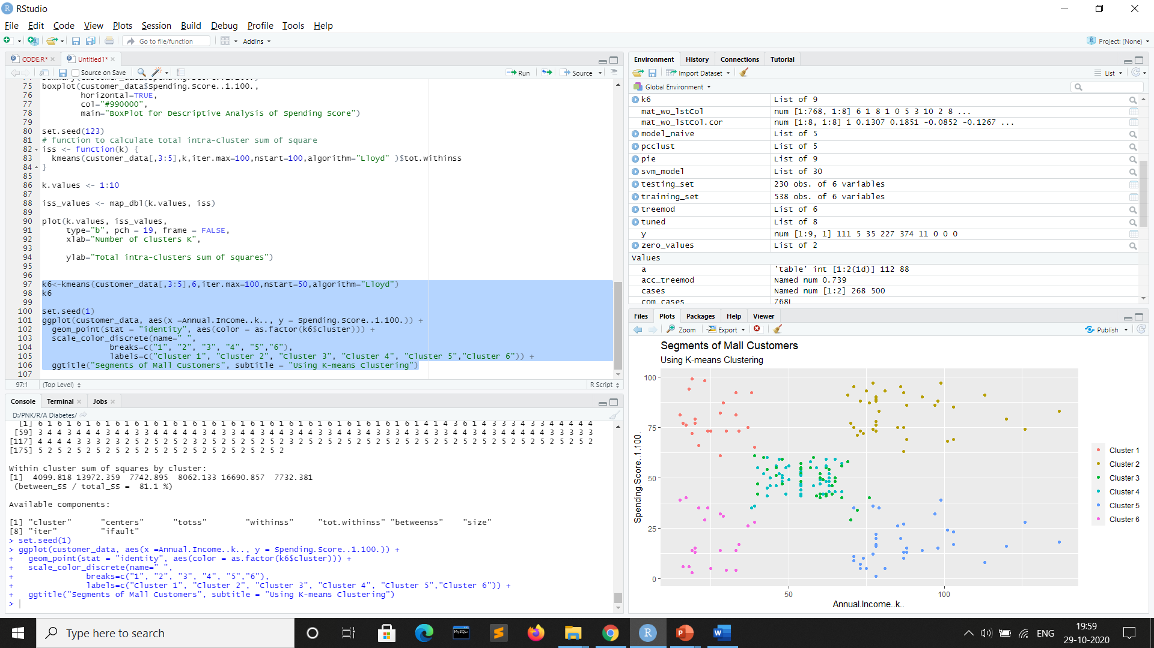
Analyzing Cluster Results

Slide 18
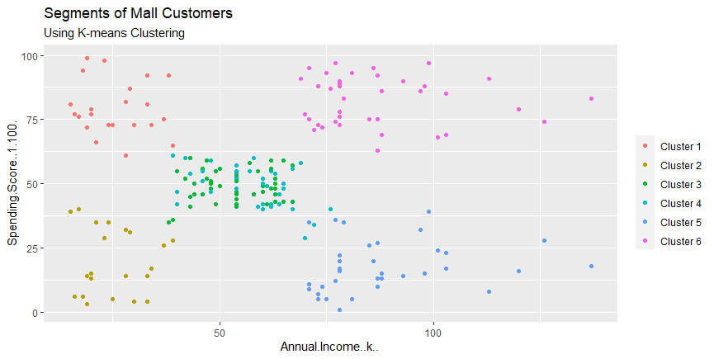
From the graph, we see that clusters are plotted on the basis of spending score and annual income curve.
Cluster 1 - This cluster denotes a low annual income and low spending score.
Cluster 2 - These clusters represent the customer data with the low annual income salary and high spending score.
Cluster 3 & Cluster 4 - This clusters represents the customer data having a medium annual income as well as a medium spending score.
Cluster 5 - This cluster represents a high annual income and high spending score.
Cluster 6 - This cluster denotes the customer data with high annual income and low spending score.
Result - Finally, we can assume that to increase the profits of the mall, the mall authorities should target people belonging to cluster 5 and cluster 3 alongside maintaining its standards to keep the people belonging to cluster 1 2 4 and 6 also.

Slide 19
THANK YOU !

